Slide 1
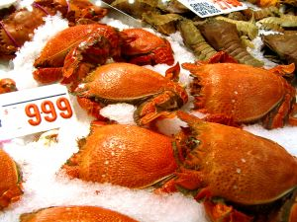
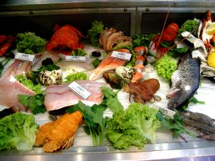
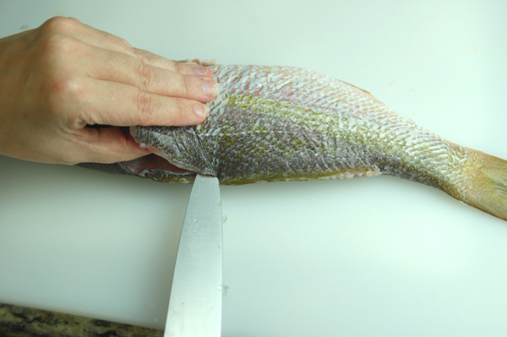
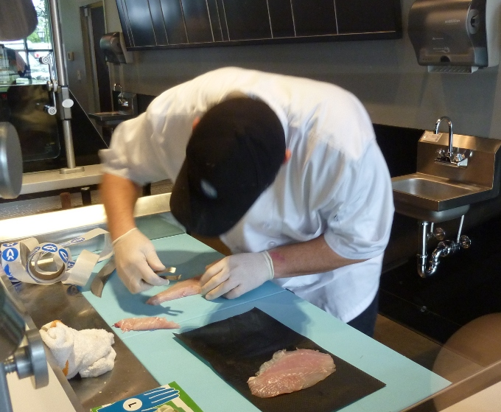
PREPARE AND COOK SEAFOOD
D1.HCC.CL2.10
Notes:
Trainer welcomes trainees to class and explained the topic for today is “Prepare and cook seafood”.

Slide 2

Prepare and cook seafood
Assessment for this Unit may include:
Oral questions
Written questions
Work projects
Workplace observation of practical skills
Practical exercises
Formal report from employer/supervisor
Notes:
Trainer to advise:
Trainer advises students that assessment for this Unit may take several forms all of which are aimed at verifying they have achieved competency for the Unit as required.
Trainer indicates to students the methods of assessment that will be applied to them for this Unit.

Slide 3

Prepare and cook seafood
This Unit comprises five elements:
Identify and select fish varieties
Identify and select shellfish varieties
Prepare fish and shellfish
Cook and present seafood
Store fish and shellfish to enterprise requirements
Notes:
Trainer to advise:
Trainer advises students this Unit comprises five elements, as listed on the slide explaining:
Each Element comprises a number of Performance Criteria which will be identified throughout the class and explained in detail
Students can obtain more detail from their Trainee Manual
The course presents advice and information but where their workplace requirements differ to what is presented, the workplace practices and standards must be observed.

Slide 4
Prepare and cook seafood
Element 1: Identify and select fish varieties
Identify a selection of fish varieties
Identify commercial cuts of fish for menus
Identify and select suppliers for purchasing of products
Minimise wastage through correct purchasing
Identify costs through yield testing
Notes:
Trainer to advise:
Relate the performance criteria to element 1.

Slide 5
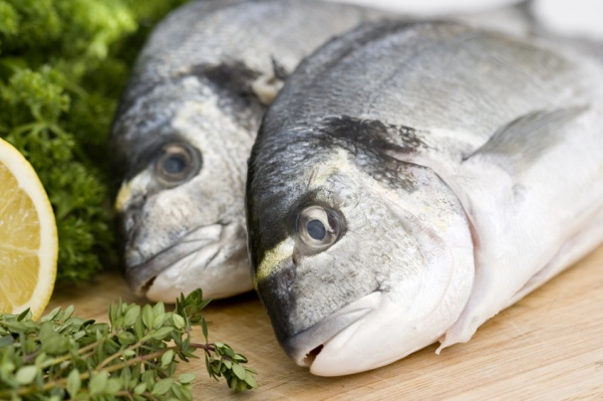
Identify and select fish varieties
Identify a selection of fish varieties
Salt water:
Bream
Mackerel
Dory
Flathead
Snapper
Shark
Notes:
Trainer to advise:
Students need to become familiar with the name of both freshwater and saltwater fish in the market place

Slide 6
Identify and select fish varieties
Identify a selection of fish varieties
Freshwater:
Trout
Cod
Barramundi
Perch
Redfin
Notes:
Trainer to advise:
Even when you are in the same country like Australia fish can be the same but called by another name

Slide 7
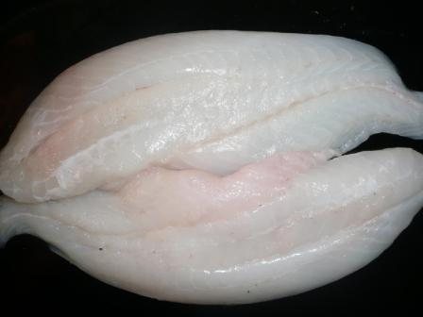
Identify and select fish varieties
Identify a selection of fish varieties
Many species abound
Different country : Different name : Same fish
Develop research skills
Identify commodity
Types:
Flat fish – 4 fillets
Round fish – 2 fillets
Notes:
Trainer to advise:
Develop skills in purchasing
Develop relationship with suppliers for their guidance
Types:
Fish can be round or flat
Round are the most prolific; get more flesh from larger round fish; 2 fillets
Flat fish have 4 fillets; they tend to be smaller in size

Slide 8
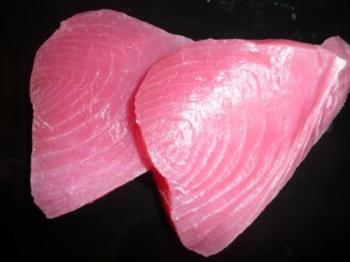
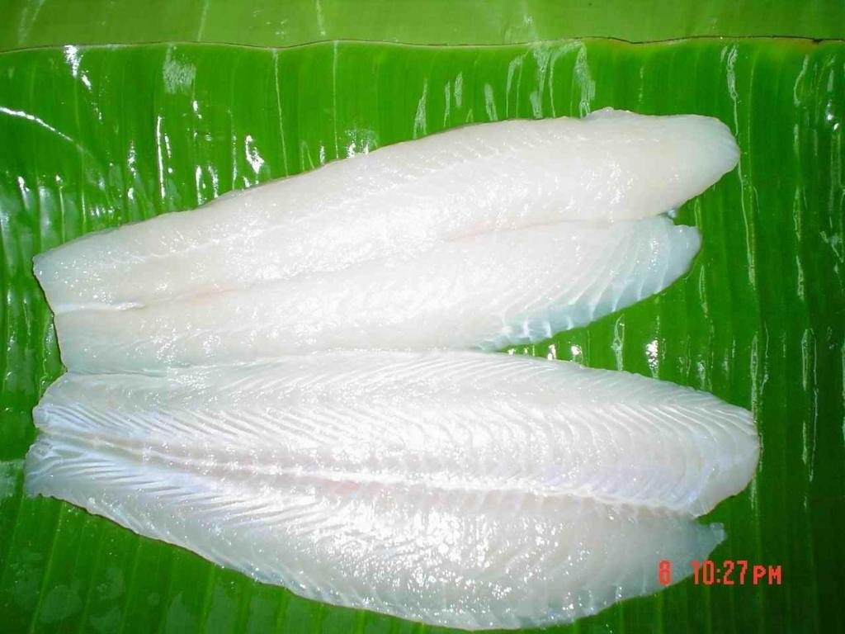
Identify and select fish varieties
Identify a selection of fish varieties
Types:
Flesh Colour – Dark or White
Dark (oily) – Salmon; Mackerel; Tuna; Trout
White – Bream; Snapper; Cod; Perch
Notes:
Trainer to advise:
Develop skills in purchasing
Develop relationship with suppliers for their guidance
Flesh colour:
Dark flesh fish have more oil; stronger more pronounced flavours; cooked to rare in centre
White flesh have more delicate subtle flavours; need to be cooked totally

Slide 9
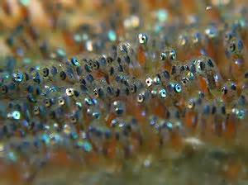
Identify and select fish varieties
Identify a selection of fish varieties
Concerns
Problems arising from catching under-grown/under-developed seafood that are too small for use in cooking such as:
Baby crabs
Young fish or catching fish before their spawning seasons
Notes:
Trainer to advise:
How can you identify and address these concerns?

Slide 10
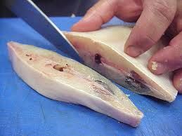
Identify and select fish varieties
Identify commercial cuts of fish menus
French cookery: French names: meaning??
Darne - Fish steak or cutlet; on the bone
A whole round fish cut through the spine
Grilled or pan fried
Served with sauce
Notes:
Trainer to advise:
Darne is a cheaper cut due to amount of bone
Not as popular in Australia as customers prefer flesh to be bone free

Slide 11
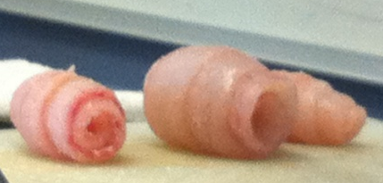
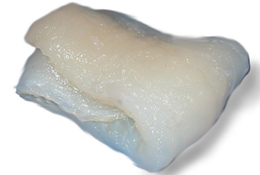
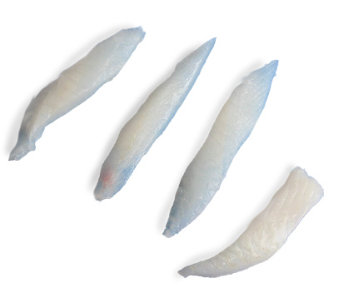
Identify and select fish varieties
Identify commercial cuts of fish menus
French cookery: French names: meaning??
Paupiette – Thin piece of flesh with stuffing
Delice – Delight; small delicate piece of flesh
Not on many menus due to production costs:
Goujon - Pin, wooden dowel; thin strip of flesh
Popular as finger food or quick oven bake
Easier to produce
Notes:
Trainer to advise:
Paupiette: Thin piece of flesh with stuffing
Delice: delight; small delicate piece of flesh
Not seen as much due to production costs
Goujon : pin, wooden dowel; thin strip of flesh
Seen more as ease of production

Slide 12

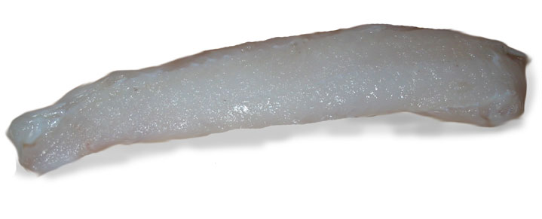
Identify and select fish varieties
Identify commercial cuts of fish menus
Supreme – Cut from the best part:
Most popular cut in restaurants
Ease of production
Fillet – whole side of a fish:
Sold in restaurants from smaller fish
Notes:
Trainer to advise:
Supremes are easiest to prepare as long as sizes are consistent
grilled; pan fried; oven baked; steamed
Fillets from smaller fish, bream, snapper, trout
grilled; pan fried; oven baked; steamed; battered or crumbed then deep fried

Slide 13

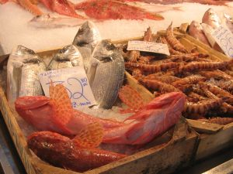
Identify and select fish varieties
Identify and select suppliers for purchasing of products
Terms of trade
Ability to supply
Ease of delivery
Quality and price
Notes:
Trainer to advise:
Terms of trade
How do they expect the produce to be paid for? Immediately; 7days; monthly?
Ability to supply
Can supplier supply what is required?
Ease of delivery
Is the supplier local; is product local or imported; can supply be rapid; today?
Quality and price
Is the quality up too standard and is the price they ask acceptable?

Slide 14
Identify and select fish varieties
Identify and select suppliers for purchasing of products
Environmental issues:
It is important to consider that problems may arise due to pollution and environmental safety concerns
For example water pollution or water which may be inhabited by sea animals that could have an adverse effect on the safety of consumers
Where and how suppliers obtain their fish is just as important as the types and quantities of fish available
Notes:
Trainer to advise:
Discuss the importance of these points.

Slide 15
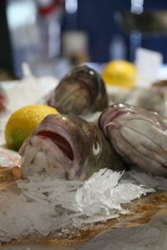
Identify and select fish varieties
Minimise wastage through correct purchasing
Purchase only what is required
Storage of product when purchased
Purchase product correctly
Notes:
Trainer to advise:
Only purchase enough product that can be used within a purchasing cycle
Can the product that has been purchased be stored safely when delivered?
Has the product been purchased correctly
Size, quantity, shape, number, flavour

Slide 16
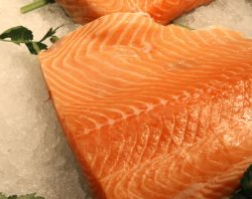
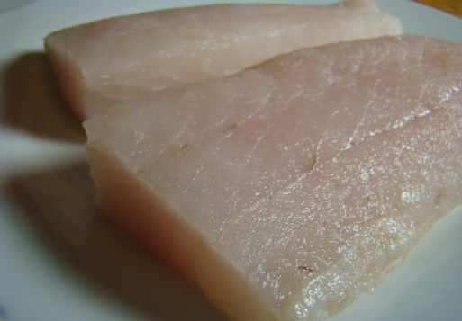
Identify and select fish varieties
Identify costs through yield testing
Whole fish
Size of fillet
Number of supreme portions
Cost per serve
Notes:
Trainer to advise:
Yield testing is about how much product from given amount of produce
If a whole fish is purchased or just whole fillets
Question
How many serves of the same size can be obtained from each fillet?
What is the cost ‘per serve’ against the cost of the fillet per kilo?
What can be done with off cuts?

Slide 17
Prepare and cook seafood
Element 2: Identify and select shellfish varieties
Identify shellfish varieties
Identify commercial cuts of shellfish for menus
Identify and select suppliers for purchasing of products
Minimise wastage through correct purchasing
Identify costs through yield testing
Notes:
Trainer to advise:
Relate the performance criteria to element 2.

Slide 18
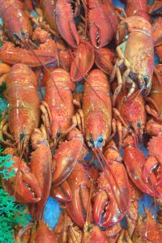
Identify and select shellfish
Identify shellfish varieties
Crustaceans:
Lobster – saltwater; have no claws
Crayfish – freshwater; have claws
Marron – Freshwater; Western Australia
Redclaw – Freshwater; Northern Queensland
Yabby – Freshwater; South East Australia
Notes:
Trainer to advise:
Student need to attach names to what is available in market place
These are names of Australian Saltwater and freshwater crustacean. Many types are available in Asian markets

Slide 19
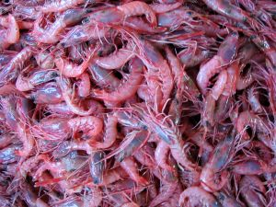
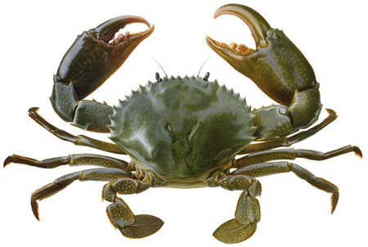
Identify and select shellfish
Identify shellfish varieties
Crustaceans:
Moreton Bay Bug - Saltwater
Balmain Bug - Saltwater
Prawns - Saltwater; many varieties
Crabs - Saltwater; many varieties
Mud crabs – Saltwater; BIG CLAWS
Notes:
Trainer to advise:
Moreton Bay and Balmain bug is the same species; both called Slipper Lobster; but they do look slightly different
Research this difference
Many types of prawn in marketplace; large and small
Mud crabs: BIG claws; count your fingers before and after handling!

Slide 20
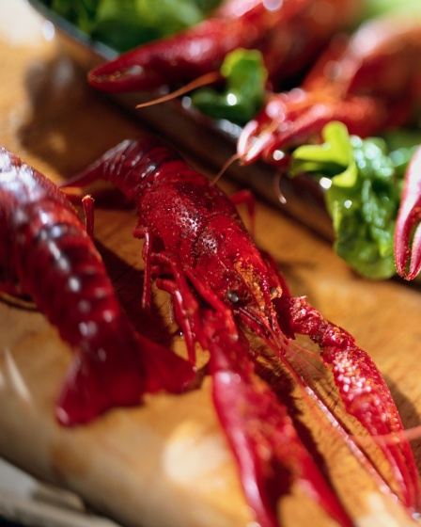
Identify and select shellfish
Identify commercial cuts of shellfish for menus
Shellfish tend to be sourced whole; in the shells
Lobsters (Southern Rock) can be purchased as:
Fresh live
Fresh cooked
Whole
Just the tail in shell; no head
Just meat - no head; no shell
Tail meat is generally frozen
Notes:
Trainer to advise:
Lobster: some say the star of the seafood world
Expensive and enjoyed across the world
Comes in all forms; live; fresh; frozen; whole ; tail in shell; tail meat only

Slide 21
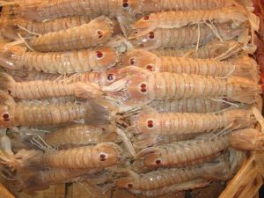
Identify and select shellfish
Identify commercial cuts of shellfish for menus
Shellfish tend to be sourced whole; in the shells
Crayfish:
Fresh water
Fresh live
Fresh cooked
Tail meat only; frozen
Notes:
Trainer to advise:
Smaller than lobsters; crayfish are freshwater crustacean
Need more per serve; various variety;
Students should research availability

Slide 22
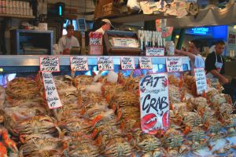
Identify and select shellfish
Identify commercial cuts of shellfish for menus
Shellfish tend to be sourced whole; in the shells
Crab:
Live; not live
Whole – fresh; frozen
Mud crab:
Fresh
Live
Frozen meat
Notes:
Trainer to advise:
Crabs are available fresh frozen or canned
Availability varies
Check local suppliers

Slide 23
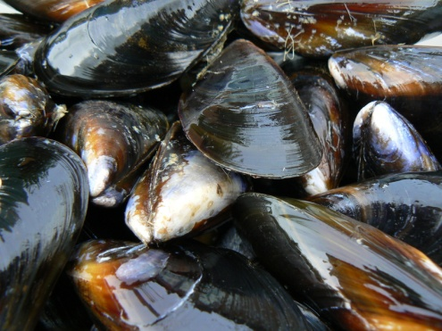
Identify and select shellfish
Identify commercial cuts of shellfish for menus
Shellfish tend to be sourced whole; in the shells
Mussels:
Live; in shell
Meat; no shell
Frozen
Pippies (Clams):
Fresh; in shell
Frozen Meat; no shell
Notes:
Trainer to advise:
Mussels are mostly purchased live;
New Zealand Green Lip Mussels are processed and frozen; frozen mussel meat is available
need to check before cooking for dead;
after cleaning plunge into cold water,
if it floats; discard

Slide 24
Identify and select shellfish
Identify commercial cuts of shellfish for menus
Shellfish tend to be sourced whole; in the shells
Scallops:
Fresh
Frozen
In shell
Roe attached
Frozen Scallop meat
Notes:
Trainer to advise:
Can be purchased fresh but these are seasonal; check with suppliers
Scallop meat is available all years round frozen
With roe attached
No roe attached
Check with suppliers

Slide 25
Identify and select shellfish
Identify and select suppliers for purchasing of products
Ease of supply
Product quality
Purchasing requirements
Notes:
Trainer to advise:
Supplier must be suitable to your needs
Can you get what you need every day
Is it fresh or frozen?

Slide 26
Identify and select shellfish
Minimise wastage through correct purchasing
Skill of staff
Purchase only what is required
Utilise excess product
Notes:
Trainer to advise:
Purchase only what is required
Ensure what you receive is what you ordered

Slide 27

Identify and select shellfish
Identify costs through yield testing
What is cost per kilo?
How many serves per kilo?
Note wastage with shell fish
Notes:
Trainer to advise:
When purchasing seafood portion yield still needs to be performed
How much is going to be put into each serve?
Shell fish have a lot of waste; shells

Slide 28
Prepare and cook seafood
Element 3: Prepare fish and shellfish
Prepare and portion fish and shellfish products to enterprise requirements
Minimise wastage/trimmings through appropriate preparation and storage
Identify and use correct equipment
Hold and kill live seafood humanely and to regulations
Notes:
Trainer to advise:
Relate the performance criteria to element 3.

Slide 29
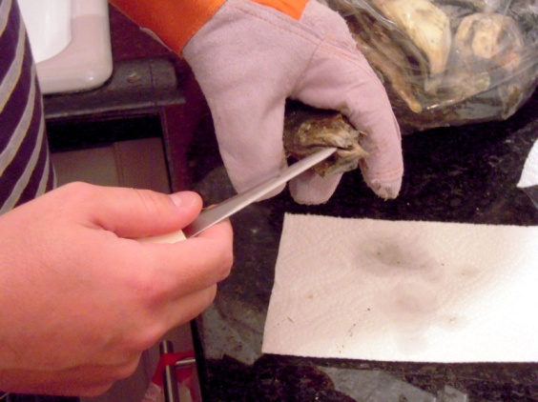
Prepare fish and shellfish
Prepare and portion fish and shellfish products to enterprise requirements
Portion yield
Cost per portion
Work involved
Staff skills
Notes:
Trainer to advise:
Ensure the portion size required is obtained
If portions are too small customers will not be happy and not return
If portion sizes are too large then profit margins will not be obtained; boss not happy
Are the staff capable of performing tasks competently

Slide 30

Prepare fish and shellfish
Minimise wastage and trimmings through appropriate preparation and storage
Skill level of staff
Method of purchasing
Customer requirements
Notes:
Trainer to advise:
If all parts of the fish are not going to be utilised then why purchase whole fish?
These decisions need to be asked as it will determine requirements when setting up business
How is food to be cooked?
Is customer going to select from live fish?
What skill level is needed in staff?
What type of customer am I going to attract?

Slide 31
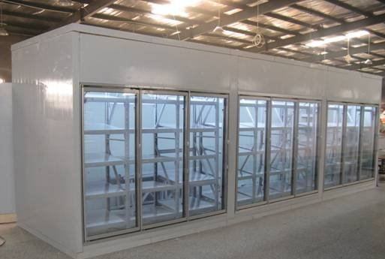
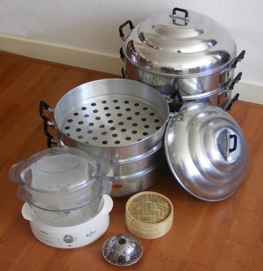
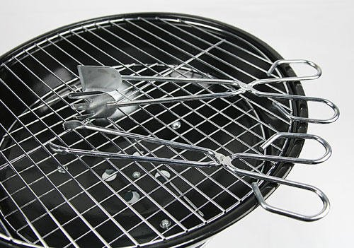
Prepare fish and shellfish
Identify correct equipment
Equipment for storage ‘raw’
Equipment for preparation and processing
Equipment for cooking
Equipment for hot holding
Notes:
Trainer to advise:
Equipment for all steps may be required
Seafood storage areas
Cooling rooms
Workbenches and large cleaning areas
Sufficient stoves; grills; wok burners; ovens; steamers
Equipment required for hot holding; Bain Maries; hot boxes

Slide 32
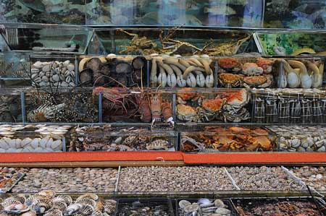
Prepare fish and shellfish
Hold live seafood humanely and to regulations
Live crustacean and Live fish:
Clean tanks - no green slime on wall
Check oxygen levels - check pH of water
Water temperature and quality - records to be kept
Floor space to keep tanks
(Floor space costs money)
Notes:
Trainer to advise:
Keeping of live animals is extra work
Tanks must be clean
Water must be clean
Keeping tanks will cost extra money and extra staff cost in caring for crustaceans and fish

Slide 33
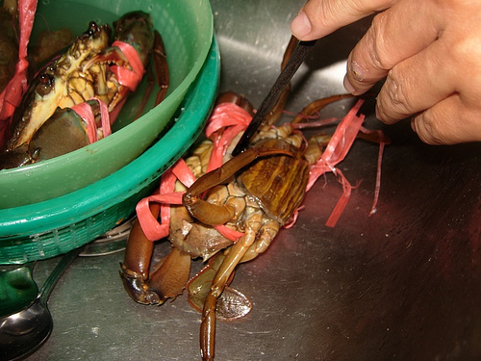
Prepare fish and shellfish
Kill live seafood humanely and to regulations
Live crustacean:
Place in ice slurry for 20 minutes
Chilling stuns the animal
Remove from ice and knife through head between eyes
No movement when touched
Notes:
Trainer to advise:
Shellfish (Lobsters and crayfish) must be stunned before killing
Ice slurry (3 parts ice/1 part water) with salt for 20 minutes
Another practice is placing in freezer for 15 minutes before cooking or cutting takes place
Remove from freezer and plunge into boiling water immediately

Slide 34
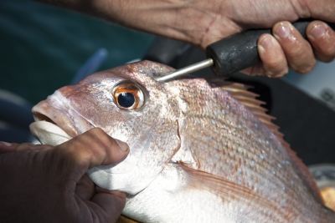
Prepare fish and shellfish
Kill live seafood humanely and to regulations
Live fish:
‘Iki Jime’ (Japanese method):
Hold live fish securely
Spike into brain and move spike to destroy brain
Cut gills to bleed fish immediately
Gut as needed immediately
Notes:
Trainer to advise:
Killing live seafood humanely takes experience and expertise
If this process is going to be part of the kitchen process ensure that staff are properly trained and competent in this skill

Slide 35
Prepare and cook seafood
Element 4: Cook and present seafood
Select appropriate cooking method to fish variety and cuts
Prepare and cook following standard recipes within a commercial environment
Hold prepared products as required prior to presenting
Present fish and shellfish, including slice/carve and portion size
Prepare garnishes, sauces and accompaniments for fish and shellfish dishes
Notes:
Trainer to advise:
Relate performance criteria to element 4.

Slide 36
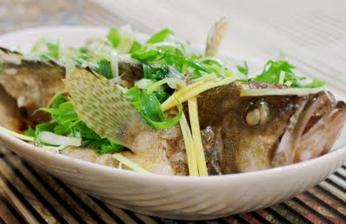
Cook and present seafood
Select appropriate cooking methods to fish and varieties
Most whole fish is best to:
Steam
Poach
Bake whole in banana leaves: this is actually steaming
Fillet portions better for grilling
Thin whole fillets
Notes:
Trainer to advise:
Seafood and fish will can be cooked many ways
Whole fish: poach; steam; bake
Portions; grill; fry; deep fry
Off cuts and small portions; Stew;

Slide 37
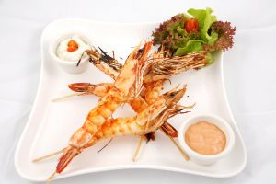
Cook and present seafood
Prepare and cook following standard recipes within commercial environment
Select recipes
Collect ingredients
Follow instruction
Cook dish
Receive feedback
Make adjustments to recipe or method as required
Notes:
Trainer to advise:
Find a recipe
Replicate that recipe
Obtain feedback
Revise where needed

Slide 38
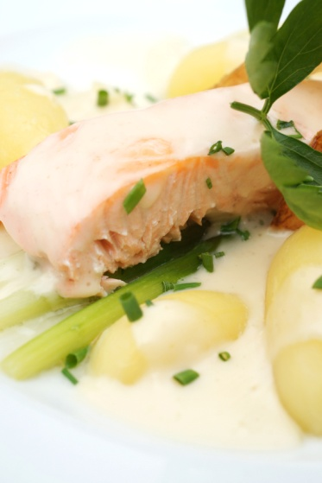
Cook and present seafood
Hold prepared products as required prior to presenting
Hold at required temperature for specified time
Cook to order
Wet dishes better than single serve grill
Notes:
Trainer to advise:
Rarely is cooked seafood ‘held’ after cooking before serving
Buffet food is the main area where seafood may be held but then it is only for short periods of time.
Seafood normally cooked to order
Seafood casseroles may be held but whole pieces tend to break up if stirred too much

Slide 39
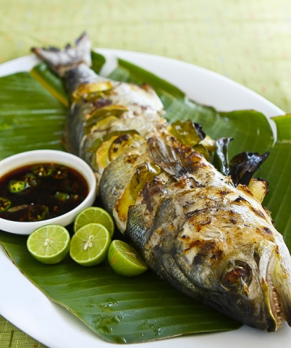
Cook and present seafood
Present fish and shellfish, including slice, carve and portion size
Whole fish can be presented:
On side
Upright
Garnish or accompaniment on side of platter
Grilled portions presented on plate with sauce
Notes:
Trainer to advise:
Many ways to present seafood dish
Final decision is up to Chef of the kitchen

Slide 40
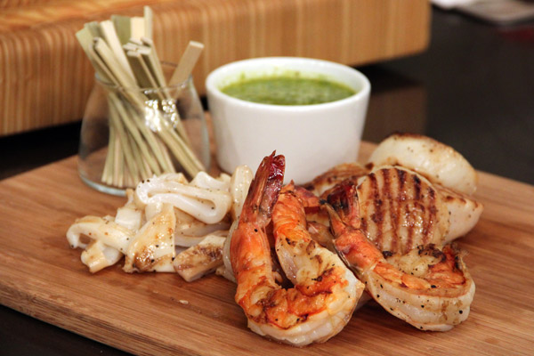
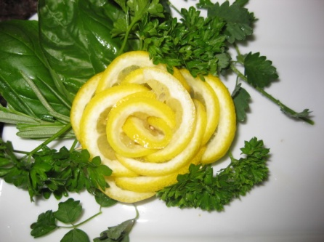
Cook and present seafood
Prepare garnishes, sauces and accompaniment for fish and shellfish dishes
Keep them simple
Make or supply fresh
Notes:
Trainer to advise:
Garnishes need to related to the dish
Need to be simple
Need to be fresh

Slide 41
Prepare and cook seafood
Element 5: Store fish and shellfish to enterprise requirements
Fresh or vacuum packed items stored correctly
Prepare and maintain correct thawing of fish and shellfish
Fish and shellfish are appropriately stored in correct containers
Fish and shellfish are correctly labelled
Ensure correct conditions are maintained for freshness and quality
Notes:
Trainer to advise:
Relate performance criteria to element 5.

Slide 42
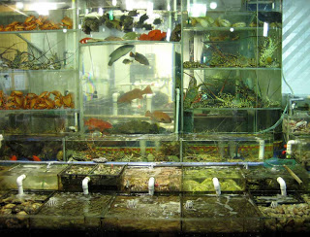
Store fish and shellfish
Fresh and or vacuum packed items are stored correctly
In tanks: if keeping and storing live fish:
Provide filtered water system
Aerate adequately
Keep out of bright lights
Comply with animal welfare requirements
Do not agitate the fish
Do not feed; this will dirty the water
Notes:
Trainer to advise:
Keeping live fish and crustacean has problems and responsibility of its own
Water storage area needs to be maintained and up to standard
Care of live animals need to be followed

Slide 43
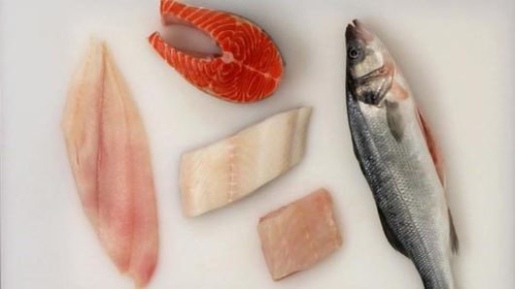
Store fish and shellfish
Fresh or vacuum packed items are stored correctly
Fresh fish - gilled and gutted:
Keep chilled
Keep moist
Keep covered
No direct contact with ice
Notes:
Trainer to advise:
Fresh killed fish need to be kept chilled as close to 0°C as possible
If ice is to be used then a clean cloth laid over fish then ice over cloth

Slide 44
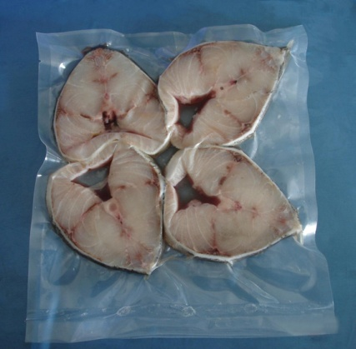
Store fish and shellfish
Fresh and or vacuum packed items are stored correctly
Fresh fish: vacuum packed:
Keep chilled in single layers in clean trays
Make sure label is still attached and in view
Notes:
Trainer to advise:
Vacuum packed foods need to be kept in single layers to ensure seal of packaging is not compromised

Slide 45
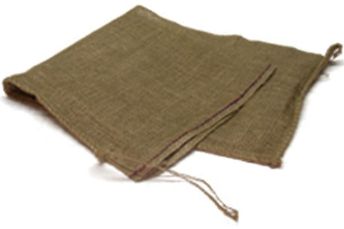
Store fish and shellfish
Fresh items are stored correctly
Fresh live shellfish:
Keep moist in wet hessian bags
Keep covered in suitable environment
Tropical lobster – 20ºC to 25ºC; 6 hours
Southern Rock Lobster – 6ºC to10ºC; 6 hours
Balmain bugs – 6ºC;12hours
Moreton Bay bugs – 12 to15ºC; 12 hours
Source information Guidelines on aquatic animal welfare; Welfare for aquaculture industry in Western Australia. 2001: Simon Benison
Notes:
Trainer to advise:
Correct storage of fresh live shellfish and storage life.

Slide 46
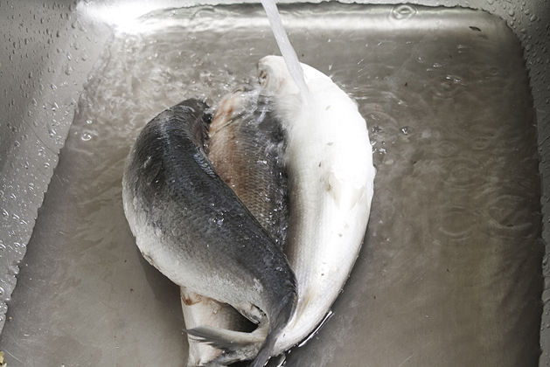
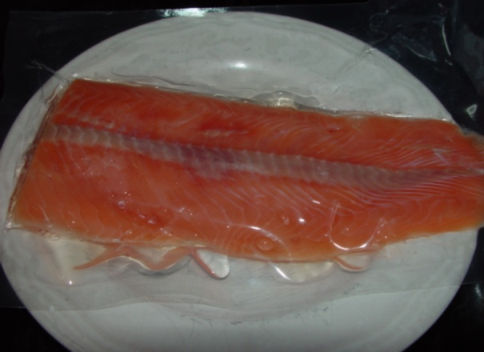
Store fish and shellfish
Prepare and maintain correct thawing of fish and shellfish
Thaw in controlled environment
Remove any accumulated water
Use as soon as possible
Notes:
Trainer to advise:
When thawing frozen product care needs to be taken that it is a controlled environment
If thawed out of coolroom product needs to be watched closely to ensure no contamination occurs

Slide 47
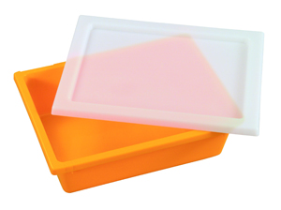
Store fish and shellfish
Fish and shellfish are appropriately stored in correct containers
Containers need to be food grade containers
Containers need to be clean
Notes:
Trainer to advise:
Product must be in correct containers
Use no container for food storage that has stored chemicals
Ensure shellfish are in stress free environment
Change containers as needed

Slide 48
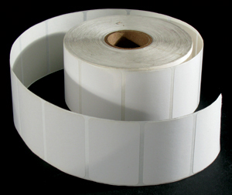
Store fish and shellfish
Fish and shellfish are labeled correctly
Label must be legible:
Name of product
Date of storage
Use by date recommendation
Name of person storing
Suppliers name and address
Notes:
Trainer to advise:
Ensure labeling is correct.

Slide 49
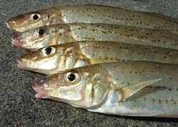
Store fish and shellfish
Ensure correct conditions are maintained for freshness and quality
Keep equipment in efficient running conditions
Keep environment clean and tidy
Remove old stock when date expires
Ensure temperatures are correct for efficient storage
Notes:
Trainer to advise:
Keep equipment in efficient running conditions
Keep coolrooms and freezers serviced to ensure efficient operation
Keep environment clean and tidy
Clean coolroom on daily basis, check all stock; change storage tray and discard melted ice
Remove old stock when date expires
Check for old stock; discard old stock; rotate old and new stock
Ensure temperatures are correct for efficient storage
Check temperatures of each area to ensure correct as they are intended to be

